Slide 1
Marxist vs “Mainstream” Economics in Pedagogy and Research: The Unity of Theory and Praxis and Socialist Construction of the Social Formation of China
Presentation to the International Symposium on the Development and Innovation of Marxist Economics
Center for Political Economy at Tsinghua University (CPET) and the Editorial Department of Economic Research Journal at the Chinese Academy of Social Science (CASS)
August 26-27, 2012
"If socialism doesn't occupy the battlefront, capitalism surely will."
Chairman Mao Zedong

Slide 2
Abstract of Paper and Presentation
ABSTRACT
The accompanying paper, The Theoretical System and Predictions of Karl Marx and Friedrich Engels: A Compendium of Assumptions, Postulates and Predictions this presentation, and modeling based upon it, explore the theoretical system of Marx and Engels as an integrated and largely coherent system of theory and praxis from which Marx made a compendium of definite and testable predictions about the logic, dynamics and trajectories of capitalism; it is important to be clear as to what Marx and Engels really wrote and argued. These predictions, one of the tests of theory and its application, are identified, formed into a compendium and sourced. Also presented in this paper and presentation are: a) some of the essential differences between Marxist versus Neoclassical or “mainstream” economics; b) some recurring and failed attempts to rescue Neoclassical economics from its own contradictions and failures in prediction and applications via policy; c) some suggestions on future approaches, modeling and projects in pedagogy and research in political economy based on Marxism and applied to the concrete conditions and realities of China.

Slide 3
Marx on The Soul of Marxism
1) ON THE UNITY OF THEORY AND PRAXIS, PRAXIS AS BASIS, RAISON ‘DETRE AND TEST OF THEORY, AND 2) UNAPOLOGETIC BIAS-PURPOSE FOR THE WORKING CLASS AND OTHR OPPRESSED AND AGAINST OPPRESSORS:
“The Philosophers have only interpreted the world in various ways; the point, however is to change it.” “Workers of all countries unite” (Inscription on the Grave of Karl Marx at High Gate Cemetery from his 11th Thesis on Feuerbach)
1) ON THE SCIENTIFIC AND NON-UTOPIAN NATURE OF MARXISM AND ITS PREDICTIONS; 2) ON THE IMPERATIVE FOR RUTHLESS HONESTY, INTEGRITY AND SOCIAL PURPOSE GUIDING ALL SCHOLARSHIP, PEDAGOGY AND PRAXIS; 3) ON THE UNIQUE CONDITIONS OF EACH SOCIAL FORMATION
“If the construction of the future and its completion for all time is not our task, all the more certain is what we must accomplish in the present: I mean, the ruthless criticism of everything that exists; the criticism being ‘ruthless’ in the sense that it does not fear its own results and does not fear conflict with the powers that be.” (Letter to Arnold Ruge 1843)
1) ON THE MASSES AND THEIR STRUGGLES, AS THE MOTIVE FORCE OF HISTORY, DEVELOPMENT OF THEORY AND PRAXIS; 2) ON THE REJECTION OF CULTS OF PERSONALITY, RECOGNITION OF ENGELS AND ALL THE SHOULDERS OF THOSE BEFORE HIM MARX STOOD UPON; 3) ON THE REPUDIATION OF MANY CRIMES DONE IN THE NAME OF MARX AND MARXISM:
“ ‘Ce qu'il y a de certain c'est que moi, je ne suis pas Marxiste.’"(Engels quoting Marx in- Letter to Bernstein, 1882.) And in the following:
"And if this man has not yet discovered that while the material mode of existence is the primum agens [primary agent, prime cause] this does not preclude the ideological spheres from reacting upon it in their turn, though with a secondary effect, he cannot possibly have understood the subject he is writing about. However, as I said, all this is secondhand and little Moritz is a dangerous friend. The materialist conception of history has a lot of them nowadays, to whom it serves as an excuse for not studying history. Just as Marx used to say, commenting on the French ‘Marxists’ of the late [18]70s: “ ’All I know is that I am not a Marxist.’ " (-Engels Letter to Schmidt, 1890.)

Slide 4
A Warning from History that Applies to Imported Theories and Ideas
“Every nation in the world has its own history and its own strengths and weaknesses. Since earliest times excellent things and rotten things have mingled together and accumulated over long periods. To sort them out and distinguish the essence from the dregs is a difficult task…Of course this does not mean that we do not need to learn from foreign countries. We must learn many things from foreign countries and master them…We learn foreign things because we want to study and develop Chinese things…We must not be like the Empress Dowager Tz’u-hsi who blindly rejected all foreign things. Blindly rejecting foreign things is like blindly worshipping them. Both are incorrect and harmful…In learning from foreign countries we must oppose both conservatism and dogmatism…To study foreign things does not mean importing everything, lock, stock and barrel…We must give our attention to the critical acceptance of foreign things, and especially to the introduction of things from the socialist world and from the progressive people of the capitalist world…” (Chairman Mao Zedong, “Talk to Music Workers”, pp. 85-88, in Chairman Mao Talks to the People: Talks and Letters 1956-1971, Stuart Schram ed., Pantheon Books, N.Y.) 1974)

Slide 5
The Socialist Social Formation of China, a System of Articulated Modes of Production, Including Capitalism, Will Deal With Capitalism Within and from the Global Economy
According to the 16th Congress of the Communist Party of China in 2002: “We must be aware that China is in the primary stage of socialism and will remain so, for a long time to come. The well-off life we are leading is still at a low level; it is not all-inclusive and is very uneven. The principal contradiction in our society is still one between the ever-growing material and cultural needs of the people and the backwardness of social production. Our productive forces, science, technology and education are still relatively backward, so there is a long way to go before we achieve industrialization and modernization.
(.“Report of the 16th Congress of the Communist Party of China”, 2002 quoted in “Some Basics on China “(online edition) by D. Raja and He Yong, Political AffairsNet, at http://www.politicalaffairs.net/article/articleview/256/1/32,p.1)

Slide 6
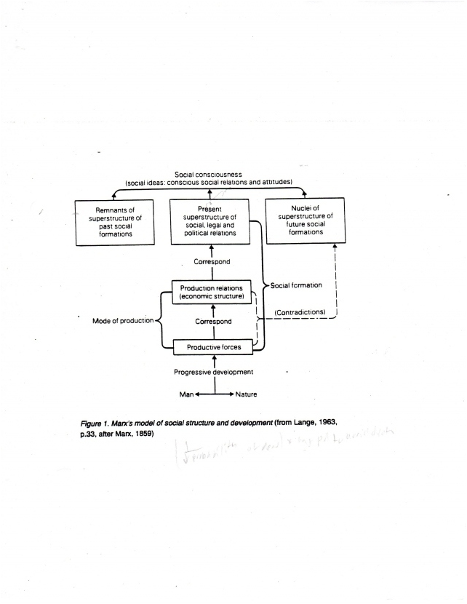
Marx’s Heuristic of Mode of Production as Both Historical Epoch and System

Slide 7
The Rhetoric of “Neoclassical” or “Mainstream” [MSE] Economics: Irrelevant Even for Understanding Capitalism as a System and Stage –Not The End—of History
“However, since 1870, triumphant marginalism has set itself the task of working out an economic science that is ‘pure’, or, more precisely, independent of all other social sciences. This ‘pure’ economic science must necessarily be a-historical, since the laws it seeks to discover have to be true whatever the economic and social system may be. Abandoning the universal outlook of Marxism, breaking down the bridges that the latter had laid between the various branches of social science it its attempt to explain history, neoclassical economics was led to become, first and foremost, an algebra of logical deductions from a certain number of axioms based on a sketchy psychology of ‘eternal man’.” (Samir Amin, Accumulation on a World Scale, Monthly Review Press, 1974, N.Y p. 5)

Slide 8
The Foundations and Pillars (“Meta-Axioms”) of Neoclassical Economics: All Refuted Repeatedly in Predictions, Applications and in Resulting Misery in Past and Current Global Crises
The first meta-axiom of neoclassical economics: methodological individualism
The second meta-axiom of neoclassical economics: methodological instrumentalism
The third meta-axiom of neoclassical economics: methodological equilibration
Source: Arnsperger, Christian and Varoufakis, Yanis, “What is Neoclassical Economics?”, Post-autistic Economics Review Issue 38, July 2009

Slide 9
Pillar I: Methodological Individualism
Individual (buyer, seller, owner) is the focus of all analysis;
Whole (Macro) = Sum of its parts; Micro → Macro;
Strict Separation of Structure from Agency: Micro → Macro but no concept of Macro → Micro;
Form of “methodological reductionism” or the notion that all large entities may be explained by reference to smaller ones;
No place for social class, race, ethnicity, gender, history, state of society or type of system, time, space, “Place”, power, politics, law, geography, or groups in decision making;
Collective action is simple aggregation of actions of “rational” utility-maximizing individuals.

Slide 10
II.Methodological Instrumentalism
All human behavior is preference driven with all preferences reduced to ultimate goals of utility maximization and minimization of pain, costs, uncertainty and risk;
Homo Oeconomicus Model (Evolving and Retreating)
a) Perfectly Rational to Bounded Rational
b) Maximizer to now Satisficer of Total Utility and Profits; calculates on the margin to maximize in Toto
c) Preferences: given Exogenous; now to adaptive Endogenous
d) Egoistic or Self-interested and competitive Individual
e) Preferences independent of influence of others or contexts; now, via Game Theory, allows some adaptation to past outcomes and context.
f) From perfectly informed on all information necessary for rational choice to “bounded” asymmetrically accessible and usable information
g) from pure competition to imperfect competition admitted.

Slide 11
III. Methodological Equilibration
Axiomatic imposition of equilibrium as focus of analysis
Questions about how, how likely equilibrium could occur in the real world never dealt with. Equilibrium merely and summarily asserted as neoclassical theory cannot demonstrate how some equilibrium could/would naturally occur out of competitive interactions of the instrumentally rational choices of “economic agents”.
Economy can be analytically detached and analyzed independent of the other dimensions of society (pure Economics instead of Political Economy)
Economy as a Morphostatic and not Morphogenetic system.
Equilibrium focus has rhetorical intention. (Who goes to the psychiatrist looking for more disequilibrium in their lives?)

Slide 12
Morphostatic (MSE) versus Morphogenetic (Political Economy) Visions of Capitalism

Slide 13
Core “First Principles” of Hypothetico-Deductivist Theory and Pedagogy of MSE
I. Principles of Individual Choice:
a) Resources are scarce;
b) real cost is opportunity cost;
c) ‘How much’ a decision on the margin;
d) people will exploit opportunities to make themselves better off;
II. Principles Underlying Interactions of Individual Choices:
a) There are gains from trade;
b) Markets move toward equilibrium;
c) Resources should be used as efficiently as possible to achieve social goals;
d) Markets usually lead to efficiency;
e) when markets do not achieve efficiency [ in their own terms], proper government intervention may be warranted and improve overall efficiency
see as a typical model of “First Principles”: Krugman Paul and Well, Robin, Macroeconomics, 2nd Edition, Worth Publishers, N.Y. pp. 6 and 11

Slide 14
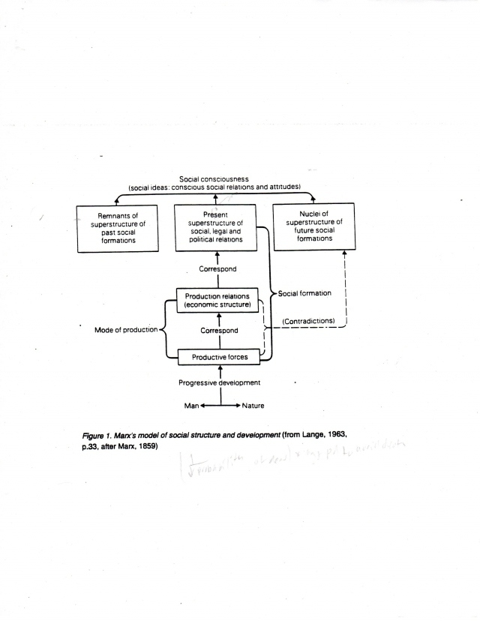

Slide 15
The Teleological “Logic” and Core of Capitalism: Production, Realization, Distribution and Utilization of Surplus Value

Slide 16
Power (ignored by MSE) Insulates Theory and Those Who Teach It From the Results of Theory and Its Applications
"Our power, then, has the grave liability of rendering our theories about the world immune from failure. But by becoming deaf to easily discerned warning signs, we may ignore long-term costs that result from our actions and dismiss reverses that should lead to a re-examination of our goals and means.“
(Republican Congressman Henry Hyde)

Slide 17
What Do You “See”? A Duck? A Rabbit?

Slide 18
Some Common Types of Errors in MSE Econometrics and Research Design and Praxis
Type I Sampling Error: ( p < .05 still gives potential Type I Sampling Error as in a set of finite data, Type I error cannot ever = 0, thus always a probability a true hypothesis is rejected even when correctly specified)
Type II Specification Error: (Is the IF statement of the hypothesis correctly specified; ordinary least squares-model assumes: regressors are exogenous; error terms are assumed homoskedastic, uncorrelated and sometimes normally distributed) Violations of these assumptions common thus Type II errors.
Type III Methodological Errors: a) Measurement error; b) Data mining; c) Duhem-Quine Critique; d) Publication Bias; e) Historical events sui generis; f) add: ceteris paribus/a-contextuality; g) confirmation bias; h) fallacies (composition, division etc)
(See: Hollanders, D.F. “Five Methodological Fallacies in Applied Econometrics”, Real World Economics Review, No. 57. pp 115).

Slide 19
Current Crises → Retreat [Again] to Joseph Schumpeter the “Anti-Marxist ‘Marxian’ ”
With “Mainstream Economics” increasingly under siege from the realities, data, patterns and crises that its practitioners said could never happen in the long-run but have occurred again, now how to rescue capitalism, and its supporting “mainstream” theory, from its own supporters, their theories and their repeatedly failed and bankrupt predictions and policy applications of theory?
Answer: The periodic crises and wild swings in major economic aggregates, yes “may” contradict the Neoclassical narrative of a self-organizing/stabilizing/renewing/equilibrating/reproducing or “auto-poietic” capitalism, but they provide the evidence of positive effects of the hurricane or typhoon-like “Gales of Creative Destruction” out of the periodic turmoil of capitalism: “Wei Ji” Danger and Opportunity

Slide 20
Polemicists for MSE and Neo-liberalism Find and Need Schumpeter--Again
“We are now living it is said, in the Age of Schumpeter…Schumpeter was a powerful prophet and he now offers dazzling insights into everything from the rise of Walmart to prosperity’s discontents. He is best known for his evocative phrase Schumpeter saw capitalism as a system that produces ‘creative destruction’. unleashes material progress—raising living standards, more creature comforts—through the turmoil of new technologies and business methods. The ‘entrepreneur’, a man of great vision and energy (in his day, there were few women in business) was the driving force of change. Indeed Schumpeter’s idea of chaotic capitalism seems everywhere confirmed.”
(Robert J. Samuelson, Newsweek and Neoclassical/Neoliberal Polemicist)

Slide 21
Can Capitalism [and its supporting MSE theory] Survive?
From the book “Can Capitalism Survive?: Creative Destruction and the Future of the Global Economy, Harper Books, N.Y. 1976 by Joseph Schumpeter (a new book created from excerpts from Joseph A. Schumpeter’s Capitalism, Socialism and Democracy):
“How do we put the financial crisis behind us and get growing again? The answer is in rediscovering the essence of entrepreneurial capitalism. As Joseph Schumpeter, the twentieth century’s foremost economist, observed, dynamic growth requires constant innovation and volatility. That’s capitalism, and it works. It is our way forward.” (Steve Forbes, Forbes Magazine on the cover of the book).

Slide 22
What was Schumpeter’s Answer as to the Stability-Survivability of Capitalism?
“Can capitalism survive? No, I do not think it can. But this opinion of mine, like that of every other economist who has pronounced upon the subject, is in itself completely uninteresting. What counts in any attempt at social prognosis is not the Yes or No that sums up the facts and arguments which lead up to it but those facts and those arguments themselves. They contain all that is scientific in the final result.”
“Analysis, whether economic or other, never yields more than a statement about the tendencies present in an observable pattern. And these will never tell us what will happen to the pattern but only what would happen if they continued to act as if they have been acting in the same time interval covered by our observation and if no other factors intruded. ‘Inevitability’ or ‘necessity’ can never mean more than this.” (Joseph Schumpeter, Prologue, p1)

Slide 23
Schumpeter as a “Social Astronomer” and Prognosticator of Capitalism
“One more point before we start. The thesis I shall endeavor to establish is that the actual and prospective performance of the capitalist system is such as to negative[sic] the idea of its breaking down under the weight of economic failure [Marx], but that its very success undermines the social institutions which protect it, and ‘inevitability’ creates conditions in which it will not be able to live and which point to socialism as the heir apparent. My final conclusion therefore does not differ, however much my argument may, from that of most socialist writers and in particular from that of all Marxists. But in order to accept it one does not need to be a socialist. Prognosis does not imply the desirability of the course one predicts. If a doctor predicts that his patient will die presently, this does not mean that he desires it. One may hate socialism or at least look upon with cool criticism, and yet foresee its advent. Many conservatives did and do.’
“Nor need one accept this conclusion in order to qualify to be a socialist. One may love socialism and ardently believe in its economic, cultural and ethical superiority but nevertheless believe at the same time that capitalist society does not harbor any tendency to self-destruction. There are in fact socialists who believe that the capitalist order is gaining strength and is entrenching itself as time goes on, so that it is chimeral to hope for its breakdown.” (Prologue continued pp. 2-3)

Slide 24
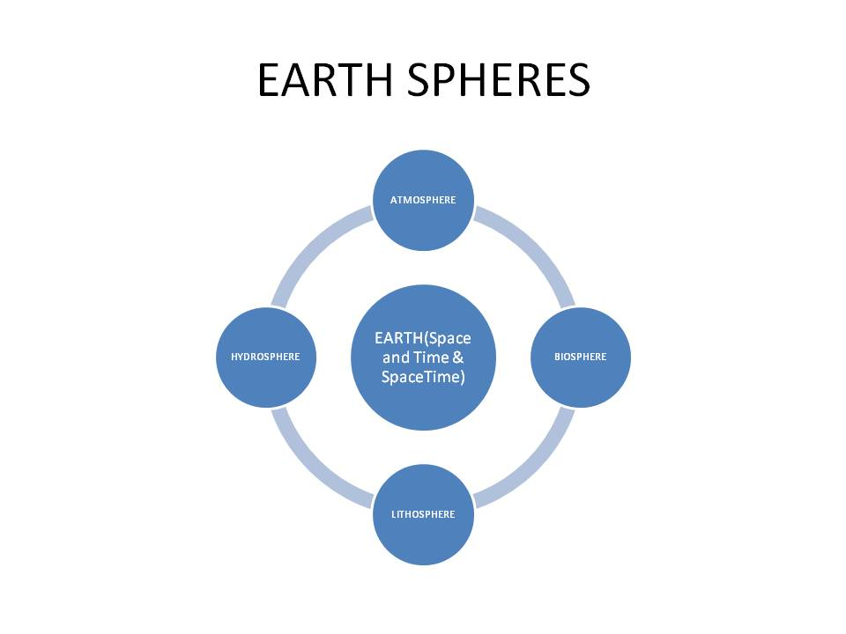
MSE Assumes Away Global Contexts and Endogeneity Among and Between Dimensions of the Global System

Slide 25
Some Contrasts Between MSE and Marxist Political Economy I
NEOCLASSICAL ECONOMICS
1. ANALYTICAL FOCUS: INDIVIDUALS
2. FOCUS: DIMINISHING RETURNS
3. SYSTEMS: ESSENTIALLY MORPHOSTATIC
4. MICRO → MACRO (WHOLE = SUM OF PARTS)
5. ECONOMY AS SEPARATE SPHERE OF SOCIETY
6. ULTIMATE INDEPENDENT AND DEPENDNT VARBLES
7. CAUSALITY LINEAR AND UNIDIRECTIONAL
8. NO SPACE, NO TIME, NO “PLACE”, NO STRUCTURE IN ANALYSIS
9. NO MONEY, DEBT, USURY, TRANS OR INFO COSTS IN ANALYSIS
MARXIST POLITICAL ECONOMY
1. FOCUS: ON SYSTEMS, GROUPS,
2. FOCUS: INCREASING RETURNS
3. SYSTEMS: ESSENTIAL MORPHOGENETIC
4. MACRO→MICRO-- ->MACRO (WHOLE = </>SUM)
5. ECONOMIC AND “NON-ECONOMIC” ARE INTEGRAL
6. NO ULTIMATE INDEP-DEPEND VARIABLES
7. ONLY “PROXIMATE CAUSALITY” OVERDETERMINATION
8.DYNAMCS OF STRUCTURE SPACE,TIME,“PLACE”,SPACE-TIME
9. MONEY, DEBT, USURY, TRANS ND INFO COSTS INCORPORATED

Slide 26
Some Contrasts Between MSE and Marxist Political Economy II
NEOCLASSICAL ECONONOMICS
10. ULTIMATE EXOGENEITY IN SOME VARIABLES
11. TECHNOLOGY AND SCIENCE EXOGENOUS
12. NEWTONIAN-LIKE MORPHOSTATICS
13. “HUMAN NATURE” CONSTANT & GENERAL
14. COMPARATIVE STATICS IN ANALYSIS
15. ELEMENTS OF ANALYSIS QUANTITIES & PRICES
16. HYPOTHETICO-DEDUCTIVIST METHODOLOGY
17. ECONOMICS AS SIMPLIFIED SOFT PHYSICS
18. FOCUS ON BARTER-LIKE EXCHANGE
19. FOCUS ON MARKETS AND INDIV EXCHANGE
MARXIST POLITICAL ECONOMY
10. NO ULTIMATE EXOGENEITY--
11. TECHNOLOGY AND SCIENCE ENDOGENOUS
12. DIALECTICAL MORPHOGENETICS
13. “HUMAN NATURE” VARIABLE/SYSTEM
14. DYNAMIC ANALYSIS SPACE AND TIME
15. ELEMENTS ARE PATTERNS & POSSIBILITIES AND SHIFTS CONTEXTS
16. DIALECTICAL INDUCTIVE-DEDUCTVE
17. POLITICAL ECONOMY AS COMPLEXITY SCIENCE
18. FOCUS ON PRODUCTION –DISTRIBN
19. FOCUS: INSTITUTIONS AND SOCIAL RELATIONS

Slide 27
Some Contrasts Between MSE and Marxist Political Economy III
NEOCLASSICAL ECONOMICS
20. NO CONCEPT POWER STRUCTURES RELNS
21. INEQUALITY IN INCOME ONLY FORM CONS
22. WANTS AND PREFERENCES EXOGENOUS
23. FOCUS: COMPETITION AND SELF-INTEREST
24. ACTORS UNINFLUENCED BY OTHERS (MI)
25. RATIONALITY AN ASSUMPTION AND GIVEN
26. ECON ACTIONS UNDER “GIVEN” CONSTRAINTS
27. HIST, GEO, POLITCS, LAW, CULTURE EXOGEN.
28. FORMAL “CLEAN”-QUANTIFIED MODELING
MARXIST POLITICAL ECONOMY
20. POWER STRUCTURES/RELATIONS CENTRAL
21. INEQUALITIES: VARIOUS INTEGRATED FORM
22. WANTS AND PREFERENCES ENDOGENOUS
23. HUMAN BEHAVIOR COMPLEX AND ADAPTVE
24. ACTORS INFLUENCED BY OTHERS AND GROUPS
25. RATIONALITY VARIABLE AND ADAPTIVE
26. ECON ACTIONS UNDER DYNAMIC CONSTRAINT
27. HIST, GEO, POLITCS, LAW, CULTURE ENDOG.
28. QUANT, QUAL, HISTORICAL, COMPAR ANALY

Slide 28
Some Comparisons between MSE and Marxist Political Economy IV
NEOCLASSICAL ECONOMICS
29. SCARCITY ETERNAL = F (WANTS > RESOURCES)
30. CHANGE CAUSED BY EXOGENOUS SHOCKS
31. ACTORS CALCULATE AND ACT ON THE MARGIN
32. COMPETITIVE MARKETS THE NORM
33. INSTITUTIONS PERIPHERAL, GIVEN, EXOGEN.
34. POSITIVE VS NORMATIVE DISTINCTIONS
35. SCIENCE SEEN AS REDUCTIONISTIC-SPECIALZD
36. TEST OF SCIENCE IS PREDICTION
37. THEORY AND PRAXIS SEPARABLE
38. ALL EXCHANGES MUTUALLY BENEFICIAL
MARXIST POLITICAL ECONOMY
29. SCARCITY VARIABLE = F (RESOURCES < WANTS)
30. CHANGE = F ( ENDOGENEITY & ADAPTATION)
31. ACTORS CALCULATE AND ACT HEURISTICALLY
32. COMPETITIVE MARKETS A-TYPICAL
33. INSTITUTIONS CENTRAL AND ENDOGENOUS
34. POSITIVE VS NORMATIVE ILLUSORY
35. SCIENCE SEEN AS HOLISITC AND INTERDISCIPL.
36. TEST OF SCIENCE IS APPLICATION-PREDICTION
37. THEORY AND PRAXIS INSEPARABLE
38. EXCHANGES MAY INVOLVE COERCION, ETC

Slide 29
Some Contrasts Between MSE and Marxist Political Economy V
NEOCLASSICAL ECONOMICS
39. WHAT, HOW, FOR WHOM? CENTRAL QUESTIONS; HOW? INCLDS WHERE? AND WHEN?
40. INDIVIDUAL BEHAVIOR = F (HUMAN NATURE, CONTSTRAINTS AND PREFERENCES)
41. ECONOMIC INTERACTIONS HAVE ELEMENTS OF COMPLETE CONTRACTS
42. STRUCTURES LITTLE FOCUS AND EXOGENOUS
43. DEGREES OF VOLATILITY GIVEN & EXOGENOUS
44. COMPETITION IS PRIMARILY BASED ON PRICE AND OTHER FORMS OF COMPETITION MARGINAL
45. CAPITALISM THE END OF HISTORY
MARXIST POLITICAL ECONOMY
39. WHAT, HOW, WHERE, WHEN, FOR WHOM, WHY, WITH WHAT IMPLICATIONS AND CONTEXTS?
40. INDIVIDUAL BEHAVIOR = F (CONTEXTS, IMPERATIVES OF SURVIVAL, INTERESTS , POWER)
41. ECONOMIC INTERACTIONS MAY NOT HAVE ALL ELEMENTS OF COMPLETE CONTRACTS
42. STRUCTURES CENTRAL FOCUS--ENDOGENOUS
43. VOLATILITY VARIABLE AND ENDOGENOUS
44. DIFFERENT FORMS OF COMPETITION, THEIR VARIABILITY ENDOGENEITY CONSIDERED
45. CAPITALISM AS A STAGE OF HISTORY

Slide 30
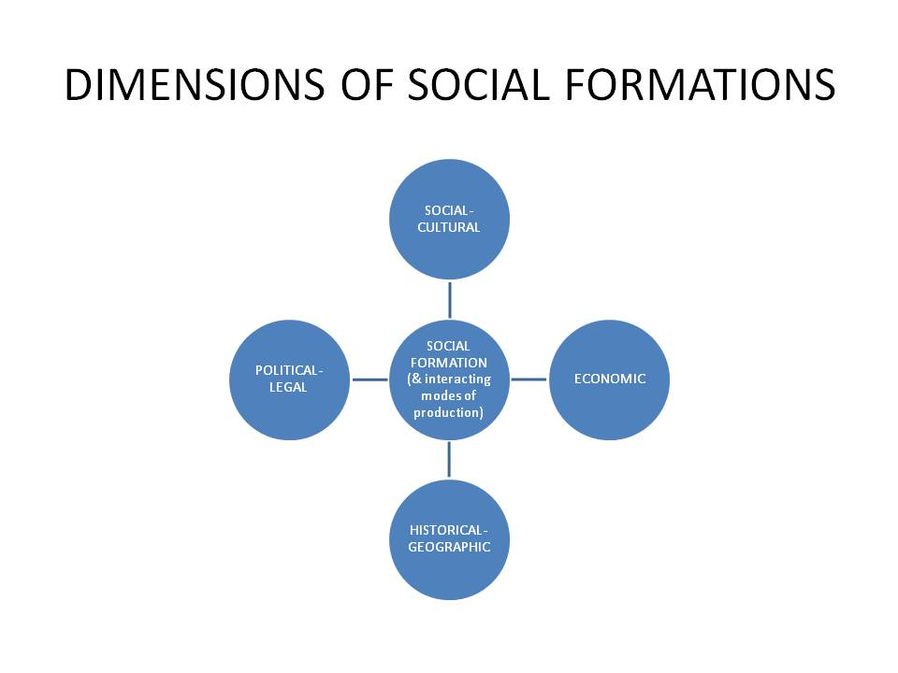
All Social Formations are Dynamic Systems of Articulated and Interacting Modes of Production Composed of Remnants of Past MOPs, a Dominant present MOP and Embryos of Future MOPs

Slide 31
The Etherial World of MSE: No Modes of Production and No History

